Slide 1
Group 2 Robot Presentation
Members: Chris D, Marwan E, Mike M.

Slide 2
Roles of Each Member:
Chris D: Owner of Github Repositories, Worked on Flowchart and Requirements Table.
Marwan E: Worked on Staffing Plans and Test Tables
Mike M: Worked on the Algorithms and Robot Videos.

Slide 3
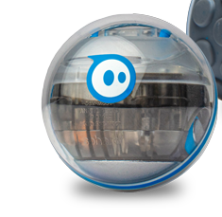

Challenges Faced:
Finding perfect time for all group members to meet when no one else is using the room.
Robot tended to be inconsistent with movements.
Robot lost battery a few times.

Slide 4

Learned about Software Engineering
The software engineering process is extremely important!
Communication within the team is essential.
Takes a lot of trial and error.

Slide 5


What We Would Do Differently:
Schedule all of the sprints in advanced rather than schedule the next sprint after the prior one was finished.
Always have the robot charged before trying to use it.

Slide 6
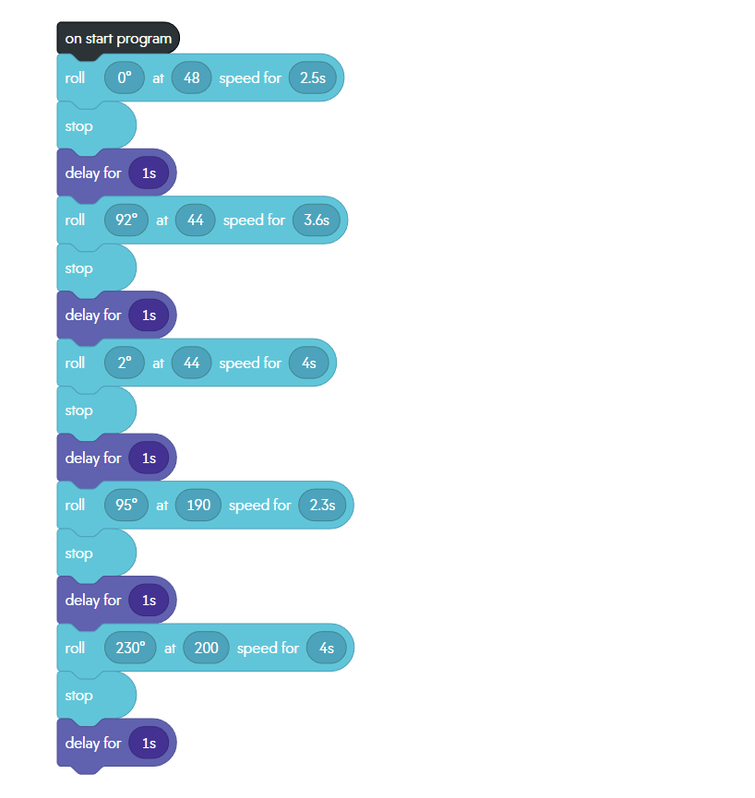
Block Code for Sprint 3:

Slide 7
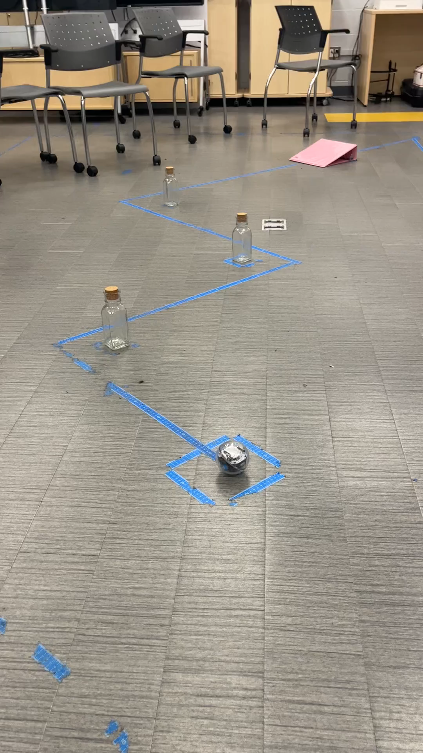
Video of Robot For Sprint 3 - Agility:

